Slide 1
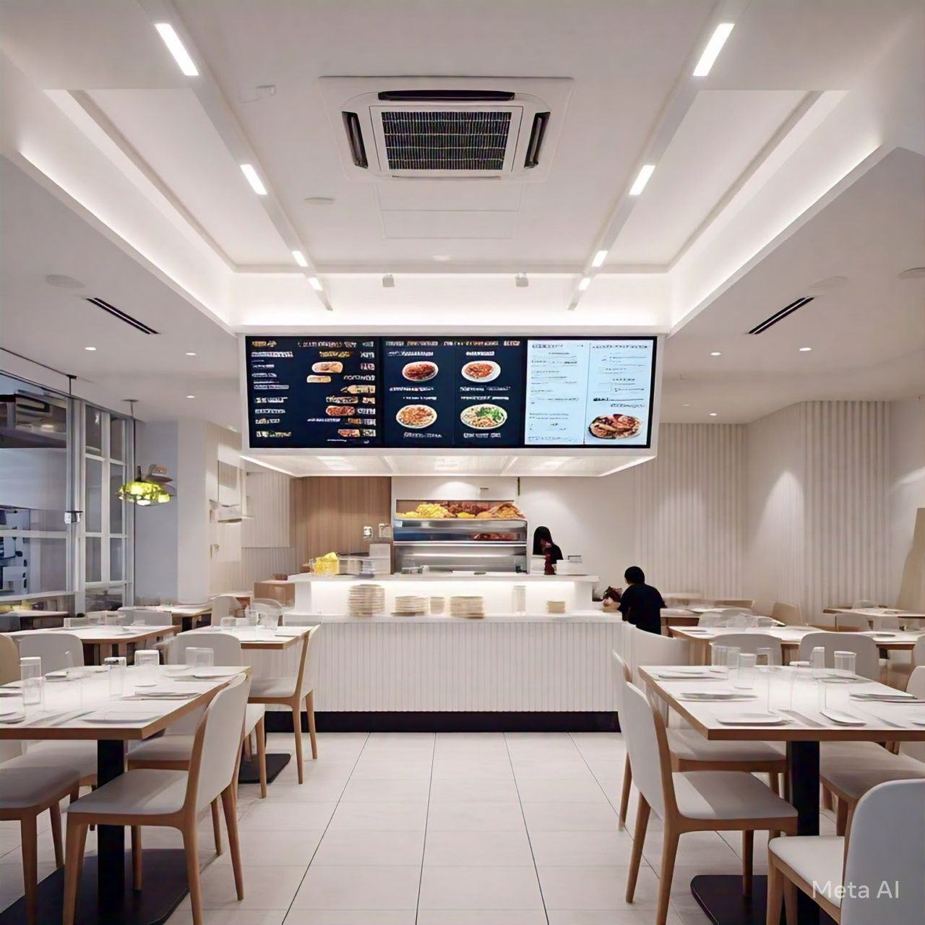
Restaurant Menu Calculator: A C++ Project
This presentation outlines the development of a comprehensive menu calculator application designed to streamline restaurant operations. It dives into the project's objectives, features, technical implementation, and future directions.
Presented by
Salman Haider BCY243058
Sharjeel Yasin BCY243067

Slide 2
Project Objectives
Automating Order Processing
Providing Detailed Reports
Automate the calculation of orders, reducing manual errors and increasing efficiency.
Generate reports on sales, popular items, and customer preferences for data-driven decision-making.

Slide 3
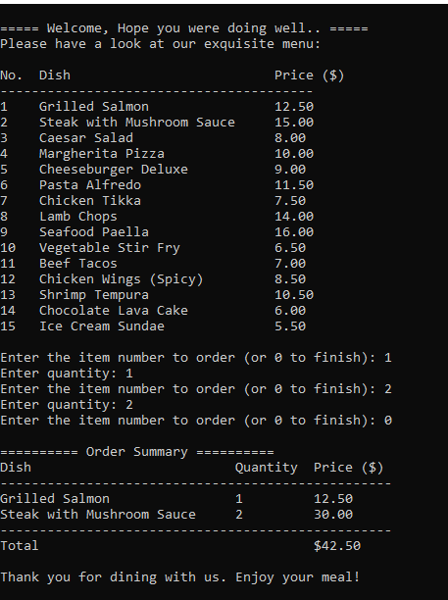
Key Features of the Menu Calculator
Interactive Menu
Order Input
A user-friendly interface that displays the restaurant's menu with prices and descriptions.
Allow users to select items, enter quantities, and modify orders.
Price Calculation
Order Management
Automatically calculate the total bill, including taxes and discounts.
Manage multiple orders, save order history, and generate receipts.

Slide 4





Functional Logic and Algorithms
Data Structures
Implement data structures to represent menu items, prices, and orders.
Input Validation
Validate user input to ensure accurate data entry.
Calculation Logic
Develop algorithms to calculate total bill, taxes, and discounts.
Report Generation
Utilize algorithms to generate reports based on order history and sales data.

Slide 5



Implementation and Coding Approach
C++ Programming
1
We chose C++ programming language for our project.
Class Design
2
Create classes for MenuItems, Orders, and Reports to encapsulate data and functionality.
Modular Design
3
Divide the code into modular functions for enhanced reusability and maintainability.

Slide 6



Tools and Techniques Utilized
C++ Programming Language
Visual Studio IDE
Use a powerful IDE to streamline code development, debugging, and testing.
Leverage the power and flexibility of C++ for efficient code execution and complex calculations.

Slide 7
Conclusion and Future Enhancements
Successful Development
1
The restaurant menu calculator successfully achieved its objectives, streamlining restaurant operations.
Future Improvements
2
Future enhancements could include online ordering integration, customer loyalty programs, and menu customization features.

